Slide 1

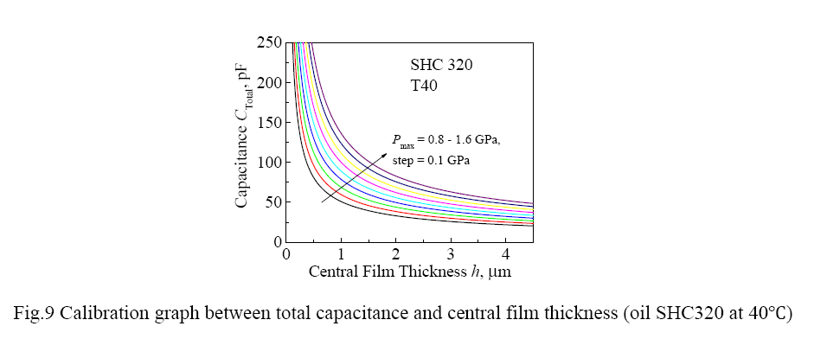
Theoretically, build the relation between film thickness and capacitance in advance, which can help you to design the test conditons (Load, Speed, temperature, et al)
know the high resolution measureable range before we go to VW. Usually the thinner the film, the higher the film thickness. But do not forget the roughness to enable a full film lubrication conditon. Also the work ability of the test rig(eg. Max load and Speed)

Slide 2
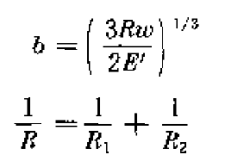
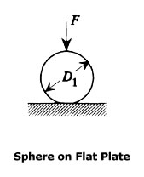

The contact area (A=Pi*b*b), we can say, it mainly follows the Hertz Contact theory. (eg. The eqs below). As reference, you can compare your results with the link: http://www.amesweb.info/HertzianContact/HertzianContact.aspx
You can calcualte the central film thickness (hc) simply use the H-D Equation (see nexe page). We imagine the film shape is uniform of the value hc in all the contact area (then more looks like a parallel capacitor).
area

Slide 3
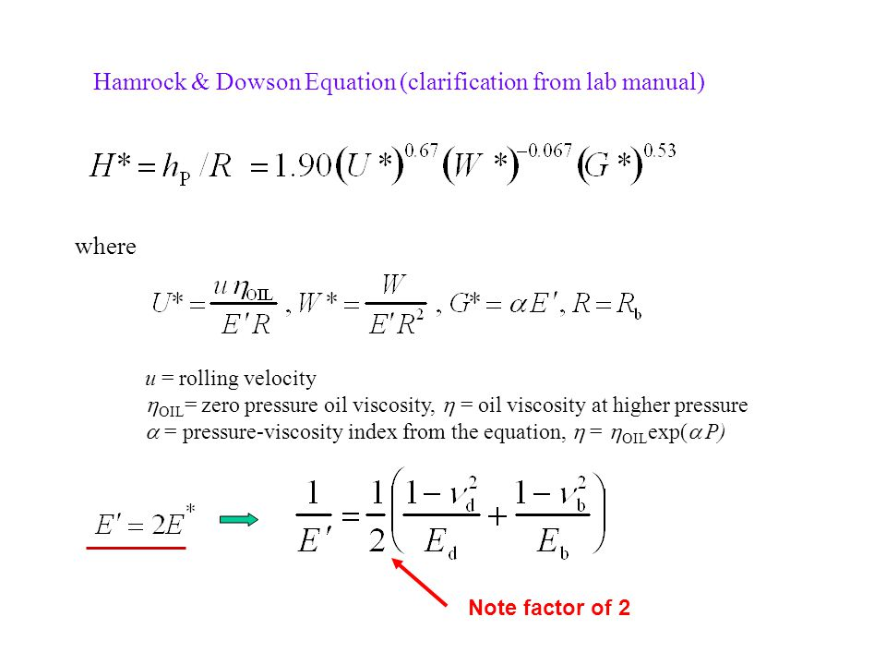
Central film thickness Eq. I just searched one on Google. Should be right---
The pressure viscosity coefficient, you can use 20E-8, if hard to get the exact value.

Slide 4
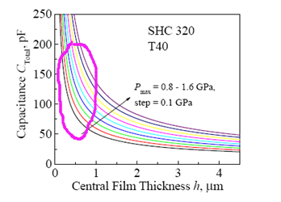
Then you get the relation of hc-capacitance.
And you can design the experimental parameters which would give high resolution.
(Design the Test Matrix –Oil Type, Temperature, Load, Speed)
Indeed, you can also write this part to your thesis and give some analysis of the measurement range info, some resolution anlysis infomation…

